Slide 1

FORECASTING LIQUOR SALES : OPTIMIZING INVENTORY AND PROMOTIONS
PRESENTED BY GROUP-10 :
Mounika Padishala (11724246)
Niharika Madhadi (11659474)
Ajith Kumar Dugyala (11758571)
Lavanya Sava (11699841)
Snehasudha Bandari (11673637)

Slide 2
Introduction
Aim : To develop a reliable sales forecasting model for a retail chain using liquor sales data, enabling data-driven decisions for optimizing inventory and planning promotions.
The main objectives of our project are:
1. Analyze the liquor sales dataset to understand historical trends and patterns. 2. Identify key factors affecting sales, such as store location, product category, and seasonal variations. 3. Develop and evaluate a predictive model for future sales. 4. Provide actionable recommendations for inventory management to minimize stockouts and overstocking. 5. Suggest promotional strategies to maximize sales and improve revenue growth.

Slide 3
Dataset Overview
We have taken the liquor sales dataset from Kaggle. From that we have filtered and worked upon latest sales data from 2015 to 2018.
The shape of the dataset is it has 24 columns and 258164 rows of data in it. It has many columns like date, store's number, name, and location. It has categories of liquor, it's vendor name and number, volume of bottle , number of bottles sold and the sales in dollars.
From this Sales (Dollars) is our target variable that we are trying to predict for future sales using input features that has some correlation with sales.

Slide 4
Data Cleaning and Preprocessing
After loading the data, we have cleaned and processed it before analyzing the data.
Have got the statistical summary for numerical columns. The sales average is 8988544, the minimum is 0 and the maximum is 26820 dollars.
Checked for missing values and handled them by imputing them with mode value of the column. Also ensured that date is in consistent format throughout the dataset.
Also checked for outliers and using IQR method we have capped the outlier values.
Then created a new column named Promotional activity and weekday. Few other columns are also added in analysis part to see effect of sales by any of these attributes.

Slide 5
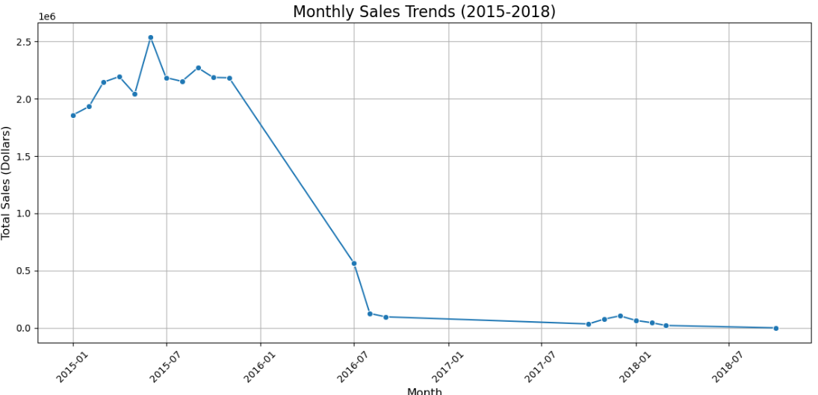
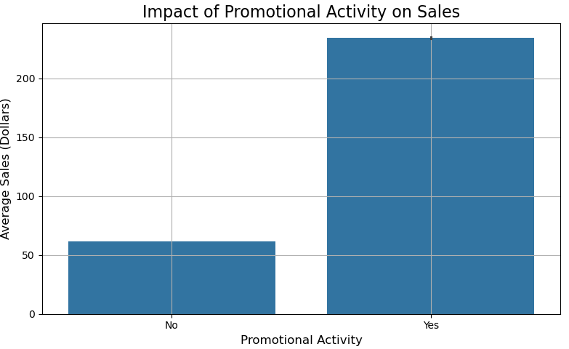
Data Analysis and Visualization (EDA)
Visualization of monthly sales trends shows that sales are higher for 2015 years and in that 6th month there are more sales, then the graph seems to be decreasing for next years.
The impact of promotional activity on sales is also shown Yes as a value in Promotional activity the average sales are higher than for No value in Promotional activity.

Slide 6
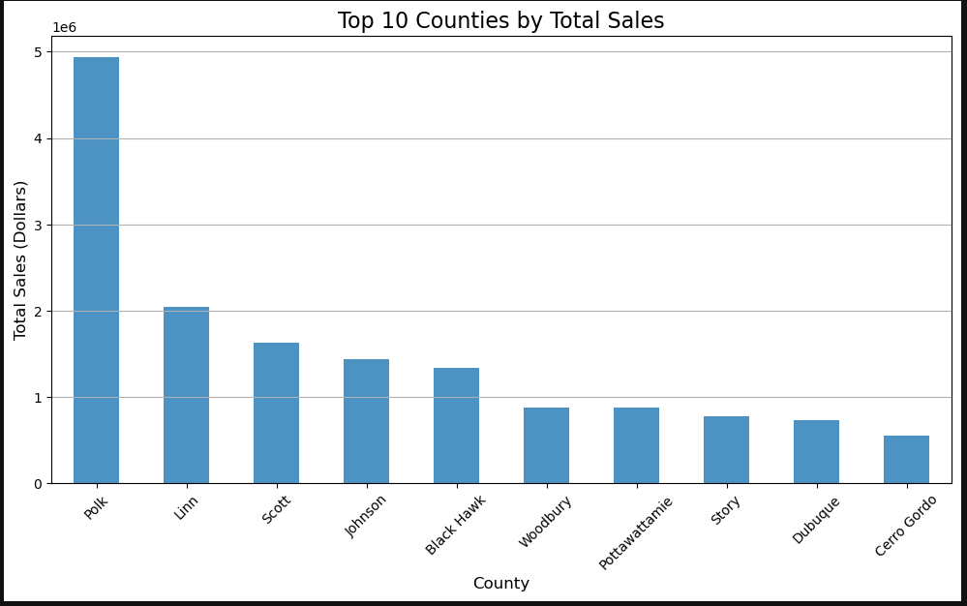
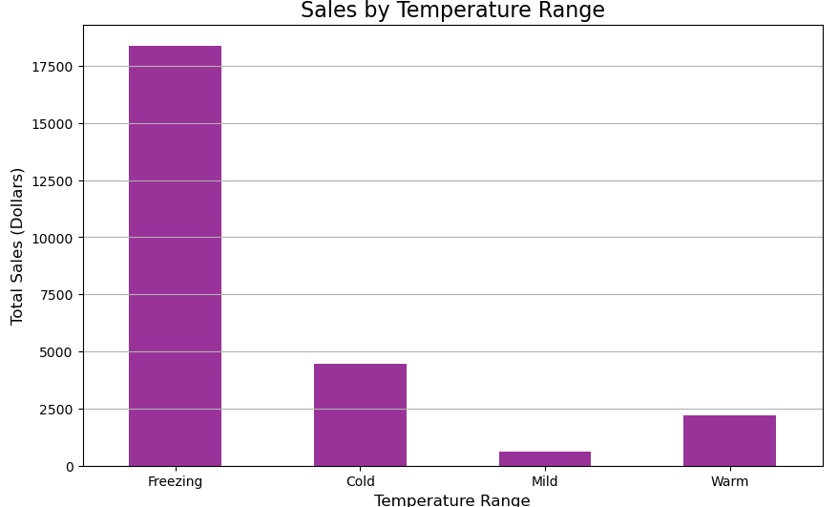
Cntd
The bar graph of top 10 counties by sales shows that the Polk county is the largest consuming county with crossing of 7.5 million dollars in the given dataset in terms of sales.
We have set the temperature ranges and checked the seasonality effect on sales. During warm and freezing temperatures, we have high sales as these are the change in seasons people tend to shop during it.

Slide 7
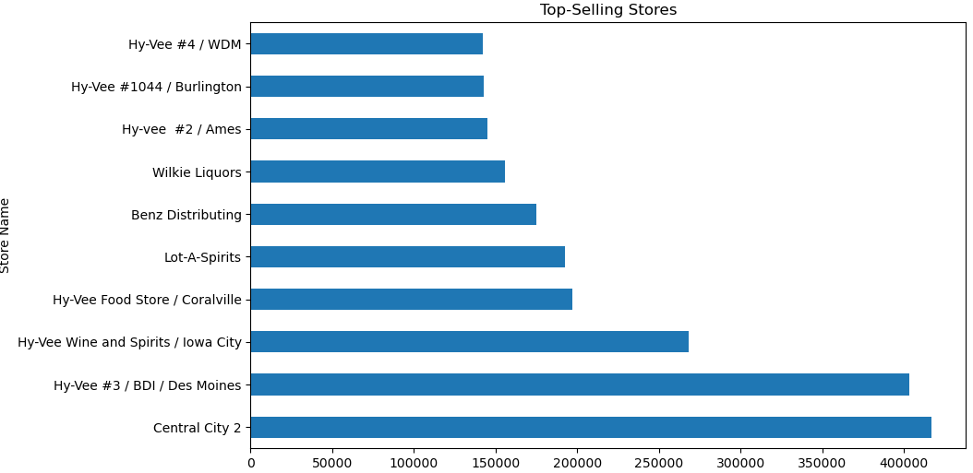
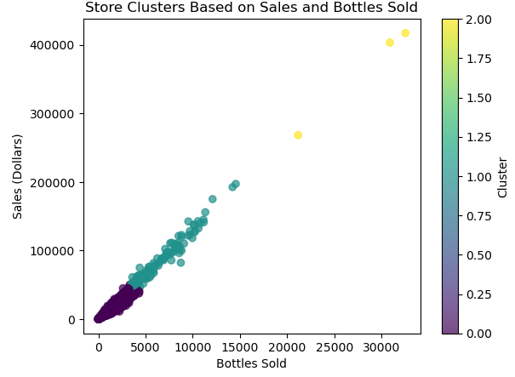
Cntd.
Top 10 most selling stores is also plotted, and Hy-Vee BDI is the most selling store which sells twice the number of sales of Sams club.
Using k means clustered stores based on sales and bottles sold. It has three clusters.

Slide 8
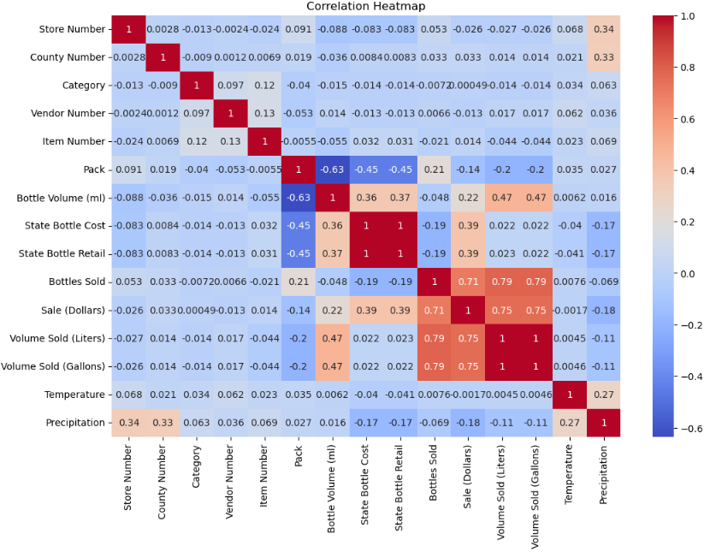
Cntd..
The correlation map of all numerical variables are plotted. There are many positive correlations between them. For example, for sales we have Profit, volume sold columns that have higher positive correlation as Profits increases as the sales increases and if more volume is sold, then sales also increases. Most negatively correlated are pack and bottle volume because if the volume of bottle is more then few of them packed and a pack with more bottles have less volume.

Slide 9
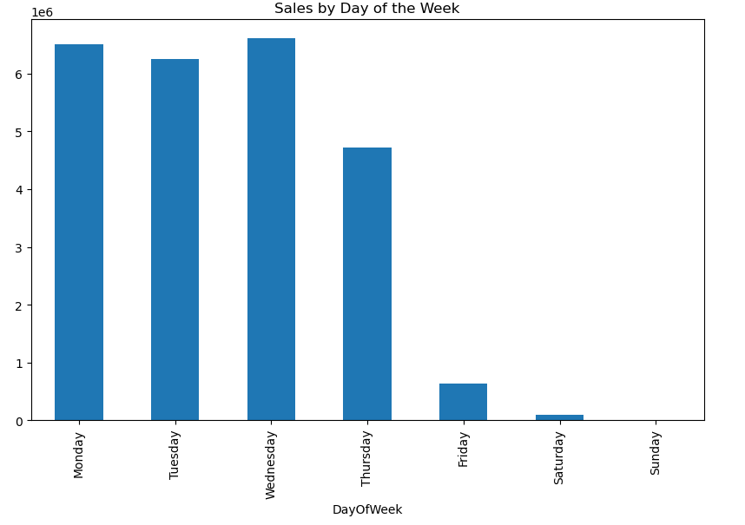
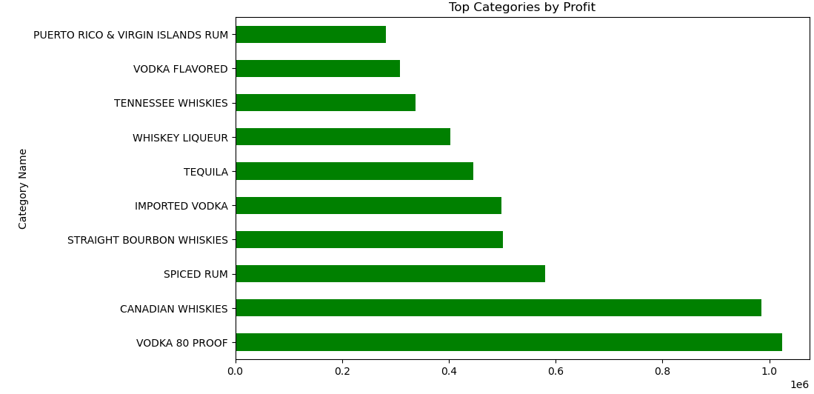
Cntd…
From weekday column, we have seen the sales for each day most of the liquor sales are done on Mondays and Wednesdays compared to other days in the week. The weekend sales are too low because on Sundays the stores are closed, and the other reason might be people might visit to bars on weekends.
From the given dataset we can observe that Canadian Whiskeys generated more profits compared to other Whiskey brands. From Vodkas, Vodka 80 proof is more profitable and spiced rum in rum category.

Slide 10
Predictive Modeling
We have tried predicting sales using three models. For all these models the features are selected based on correlation map which had less correlation with our target Sales variables are ignored, the features are 'Bottle Volume (ml)', 'State Bottle Cost', 'State Bottle Retail', 'Bottles Sold', 'Volume Sold (Liters)', 'Volume Sold (Gallons)’. With this data is split into train and test and then the models are applied on training data and predictions are done on testing data and the models are evaluated.
Linear Regression is a simpler model that we can use to compare performance against the other two models. After evaluating this model, we got MAE: 35.54505312147569, MSE: 2516.4581101518083, RMSE: 50.16431112007628, R² Score: 0.6223221072077905.

Slide 11
Cntd
XGBoost is a more advanced boosting model that often provides high accuracy for regression tasks. We got XGBoost Regressor Mean Absolute Error as 1.86.
Random forest Regressor is useful for handling large datasets and capturing non-linear relationships between features and the target variable. After evaluating this model, we got Mean Absolute Error (MAE): 1.36, Mean Squared Error (MSE): 74.74, Root Mean Squared Error (RMSE): 8.65, R² Score: 0.99.
After comparing all three models Random Forest regressor indicates an excellent fit, suggesting that the model captures almost all the variability in the target variable. It has the lowest Mean Absolute Error (MAE) of 1.36, indicating that its predictions are the closest to the actual values among the three models.

Slide 12
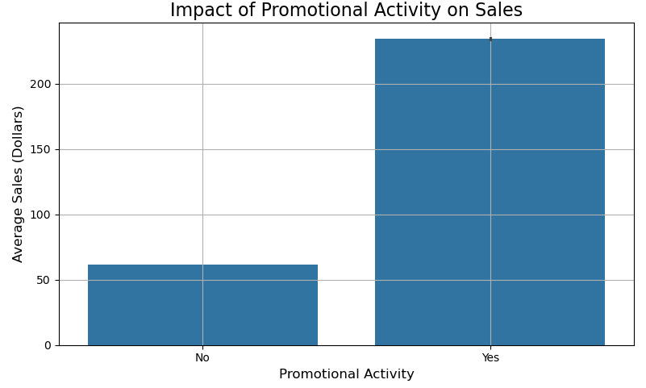
Insights and Business Recommendations
By analyzing sales data against Promotional activity, shows that if promotions are done on the products, then the sales are increasing. Marketing and sales teams can design targeted promotional campaigns around high-potential products, optimizing pricing strategies based on the model’s insights.

Slide 13
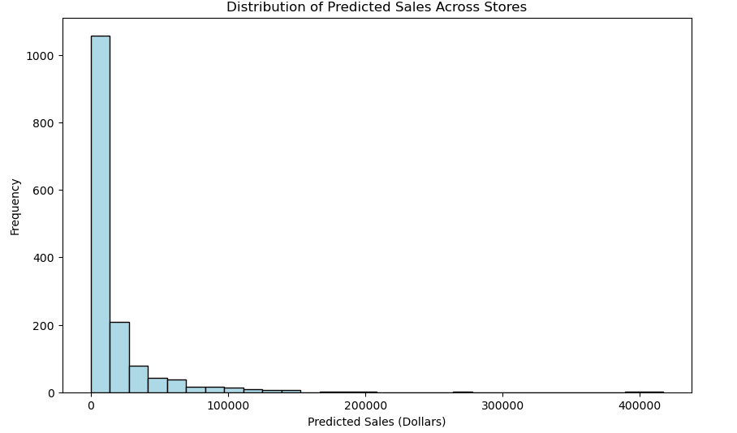
Cntd
The Random Forest Regressor model has been trained on a variety of product features such as bottle volume, cost, retail price, and sales data. The model can predict future sales based on these features, which can help forecast demand for specific products. The store management team can use these predictions to optimize inventory levels, ensuring that popular products are adequately stocked during high-demand periods.

Slide 14
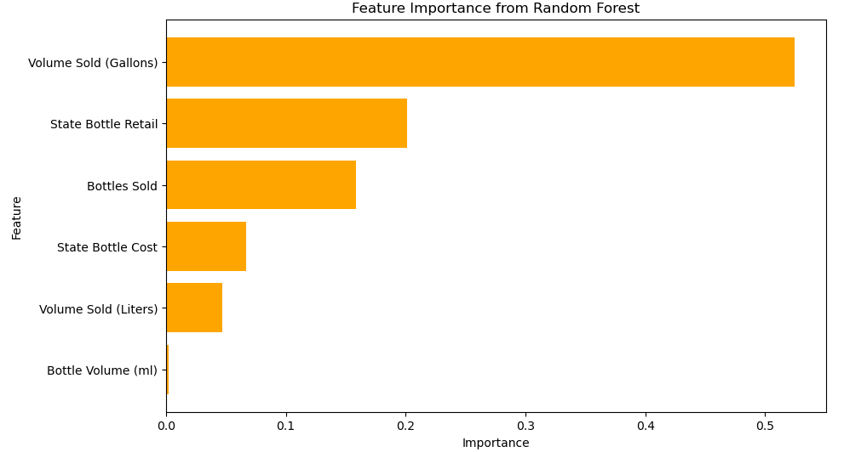
Cntd.
The model considers the State Bottle Cost and State Bottle Retail, which are key components in determining the profitability of each product. Retail managers can use these insights to adjust pricing strategies for different products, optimizing the profit margins. Feature importance analysis identifies factors like Volume Sold (Gallons), Bottles Sold, and State Bottle Retail as critical drivers of sales. This whose that Pricing and bottle sizes heavily influence customer purchases. Since bottle size and pricing are key drivers, consider dynamic pricing strategies to maximize revenue based on demand elasticity.

Slide 15
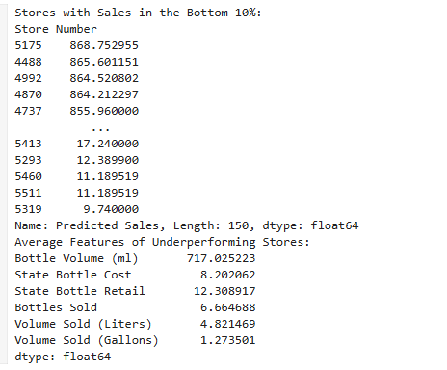
Cntd..
Identify and target the underperforming stores and the features that are making them underperform and improve these to increase their sales. Stores with sales in the bottom 10% share common traits like smaller bottle sizes, lower bottle volumes, or suboptimal pricing. Hence, introduce targeted marketing campaigns and discounts for underperforming stores and check whether changes in product offerings or location adjustments could improve performance.

Slide 16
Conclusion
Our project analyzed liquor sales data from 2015 to 2018 to identify trends, correlations, and key factors influencing sales. Random Forest Regressor proved to be the best model, achieving a MAE of 1.36 and R² Score of 0.99, making it highly accurate in predicting sales.
Insights revealed that promotional activities significantly boost sales, and bottle size and pricing are critical drivers of customer purchases. Cluster analysis helped segment stores for targeted strategies, highlighting underperforming stores and opportunities for improvement.
Our project has a business impact of Optimized inventory management can reduce overstocking by 15%, saving $1,000,000 annually. Targeted promotions can increase revenue by 5%, contributing $1.5 million annually.

Slide 17
Next Steps
As a next step, conduct time-series analysis for better demand forecasting and explore external factors like weather and holidays for enhanced predictions.
Automate periodic re-training of the model using updated sales data to maintain accuracy.
Build an interactive dashboard to display sales trends, cluster performance, and model predictions for decision-makers.
Develop customer segmentation strategies to drive loyalty and repeat purchases.

Slide 18
Thank You

